Slide 1
TRACK MARKING
DR. SUBHAS CHANDRA NANDI

Slide 2
TYPES OF TRACK SURFACE
SYNTHETIC
CINDER(UNBOUND MINERAL)
GRASS

Slide 3
400M TRACK MARKING PLAN
2 STRAIGHT LINE 84.39m x 2 = 168.78m
2 CURVES = 400m - 168.78 = 231.32m
2πr = 231.32
r = 231.32 x 7÷ 44
r = 36.80m (RDR)
Marking Distance Radius/CDR = 36.80m - 0.30m
= 36.50m
[If simple track then CDR= RDR-0.20m]

Slide 4
STAGGER DISTANCE IN 400M STANDARD TRACK
DISTANCE | BAND | LANE 2 | LANE 3 | LANE 4 | LANE 5 | LANE 6 | LANE 7 | LANE 8
200 m | 1 | 3.519 | 7.352 | 11.185 | 15.017 | 18.850 | 22.683 | 26.516
400 m | 2 | 7.038 | 14.704 | 22.370 | 30.034 | 37.700 | 45.366 | 53.032
800 m | 1 | 3.526 | 7.384 | 11.260 | 15.151 | 19.061 | 22.989 | 26.933
4X400 m | 3 | 10.564 | 22.088 | 33.630 | 45.485 | 56.761 | 68.355 | 79.965

Slide 5
The inside of the track shall be bordered by a kerb of suitable material that should be coloured white, with a height of 50mm to 65mm and a width of 50mm to 250mm.
IAAF COMPETITION RULES 2018-2019

Slide 6
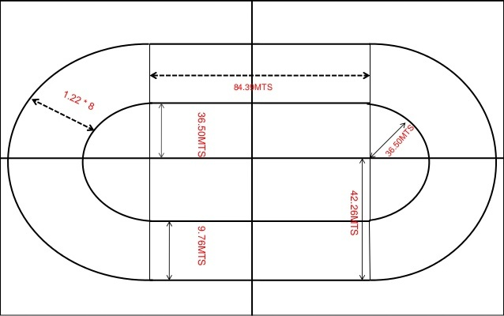
400MTS STANDARD TRACK

Slide 7
STAGGER FOR STANDARD TRACK
LANE NO 1 = NO STAGGER
LANE NO 2 = [W (N-1)-0.10]2π
N= NO OF LANE WHERE STAGGER WAS GIVEN =2
W= WIDE OF LANE=1.22MTS
= [1.22(2-1)-0.10] 2x3.14159
=[1.22x1-0.10]x 6.28318
=1.12x6.28318
=7.04MTS

Slide 8
STAGGER FOR NORMAL TRACK
LANE NO 1 = NO STAGGER
LANE NO 2 = [W (N-1)]2π
N= NO OF LANE WHERE STAGGER WAS GIVEN =2
W= WIDE OF LANE=1.22MTS
= [1.22(2-1)] 2x3.14159
=[1.22x1]x 6.28318
=1.22x6.28318
=7.67MTS

Slide 9
HIGH JUMP
ATHLETE | HEIGHTS |  |  |  |  |  |  | FALIOR | JUMP OFF |  |  | POSITION
 | 1.75m | 1.80m | 1.84m | 1.88m | 1.91m | 1.94m | 1.97m |  | 1.91m | 1.89m | 1.91m
A | o | xo | o | xo | X- | xx |  | 2 | X | O | X | 2
B | - | Xo | - | xo | - | - | xxx | 2 | X | O | O | 1
C | - | o | xo | xo | - | xxx |  | 2 | X | X |  | 3
D | - | xo | xo | xo | xxx |  |  | 3 |  |  |  | 4

